Slide 1
Problem
Solving

Slide 2
What’s the Question?
5 6 11 2 10
+ - x ÷
Which pair can get the closest to the answer using each number and operation no more than once?

Slide 3
What’s the Question?
5 7 12 10
+ - x ÷
Which pair can get the closest to the answer using each number and operation no more than once?

Slide 4
Time
Problems

Slide 5

How many minutes in an hour?
Convert these minutes to hours and minutes:
1. 68 minutes
2. 79 minutes
3. 98 minutes
4. 120 minutes

Slide 6
What do we need to consider
when trying to solve a word
problem?

Slide 7
This morning I woke up at 6:15am. It took me 1 hour and 15 minutes to get ready for school. What time did I leave the house?

Slide 8
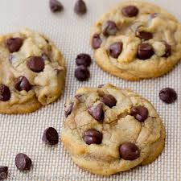
Last weekend I made cookies to take to a party.
It took 20 minutes to make the dough and 1 hour and 30 minutes to cook them all.
I started making them at 3:00pm. What time did I finish?

Slide 9
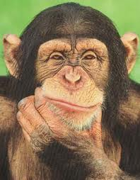
LOB: To solve one and two step word problems involving time.
Choose a time problem to solve.
Think carefully about which information is important.
Show your working out and write down the answer clearly.
Your Challenge: Answer at least FIVE questions!

Slide 10
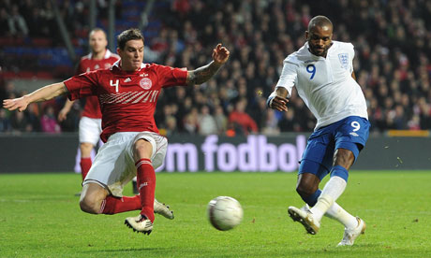
The football match kicks off at 2:30pm. Each half lasts for 30 minutes. They have a 15 minute break at half time. What time does the game finish?

Slide 11
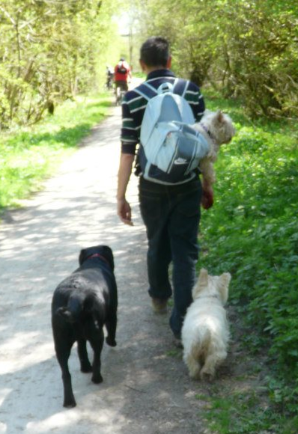
Over half term I walked the dogs for 20 minutes a day on three days of the week and an hour a day on Saturday and Sunday.
How long did I walk the dogs for altogether?

Slide 12

Make your own time problem....
What could you include?
How could you make it more complex?
What are the different ways you could work it out?

Slide 13
LOB:
To solve multiple step word problems
involving time.
Success Criteria
I can solve multiple step word problems
involving time.
I can decide which operation to use when
solving word problems.
I can check that my answer is sensible.

Slide 14
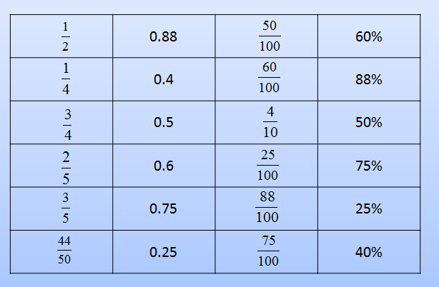
Can you find the equivalent decimals, fractions and percentages?

Slide 15
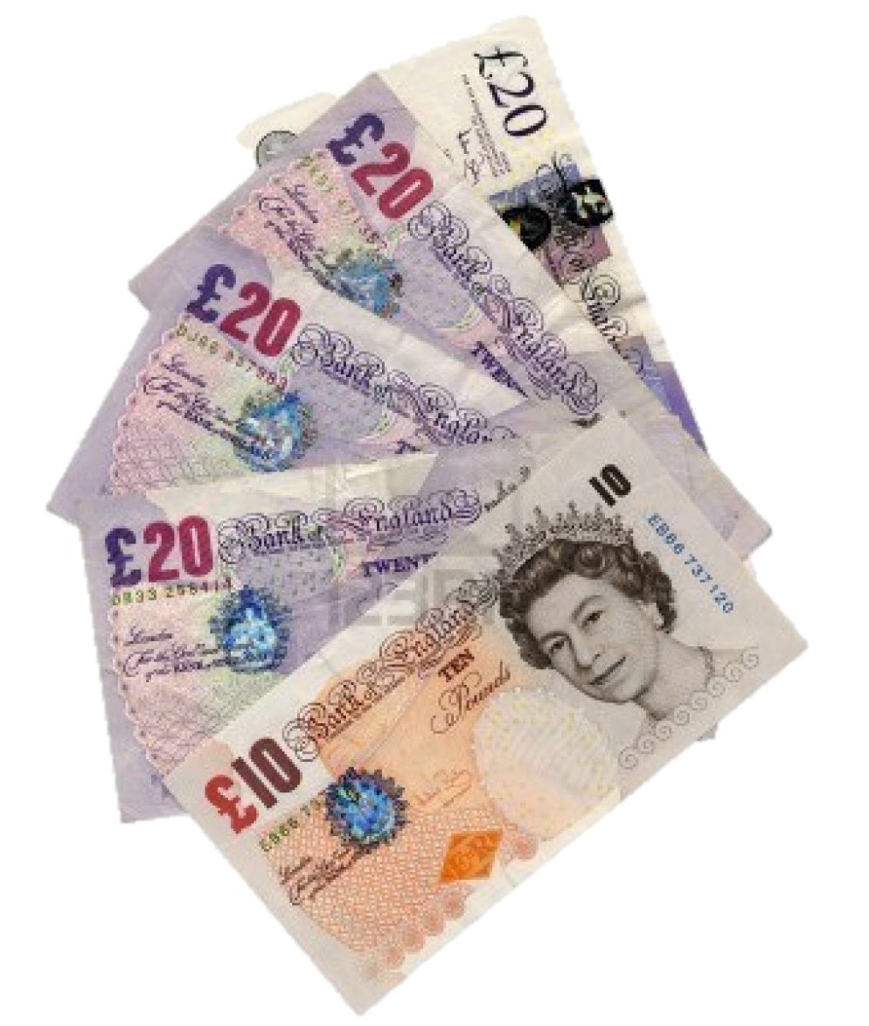
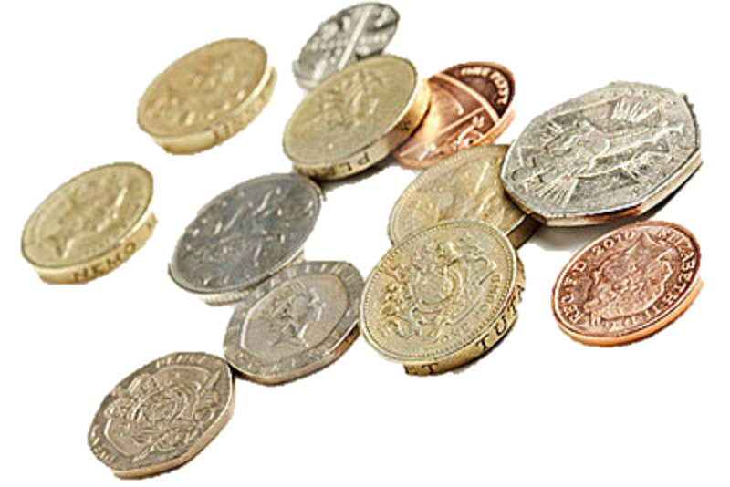
Can you work out….
£4.75 + 30p £4.55 – 98p
£12.00 ÷ 3 £36.50 x 2
(£15 x 2) + (£10.50 x 2)

Slide 16
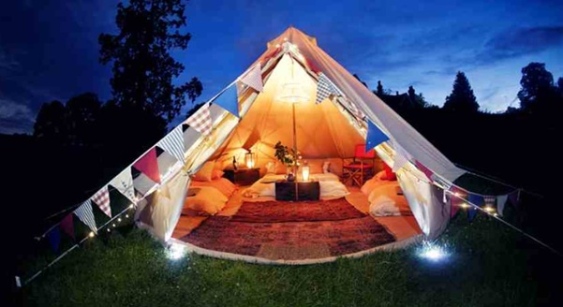
It won’t be long until the summer holidays
and lots of people really like to go camping.
Can you help plan a glamping holiday?

Slide 17
The Glamping Challenge
You have a budget of
Which team can plan the best holiday, getting as close to £800 as possible without going over?
£800

Slide 18
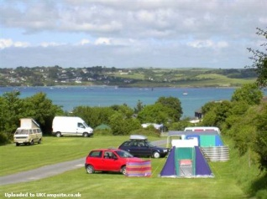
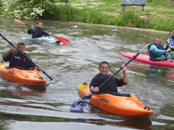
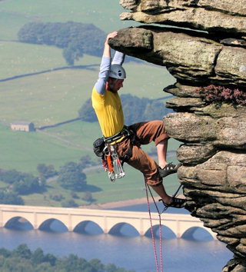
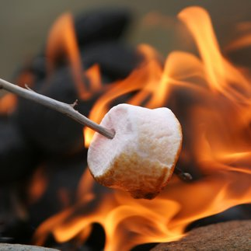
You will have to work together to choose where to go, what activities to do, what food to buy and which equipment you’ll need!

Slide 19
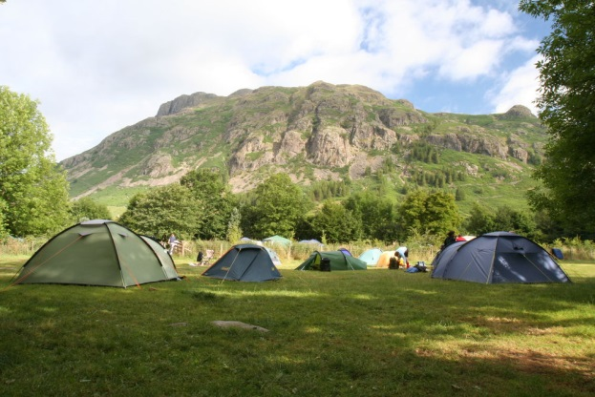
Sunny Hills Campsite
Adults - £20 per night
Children – free
25 miles away from home (petrol is 10p per mile).
Car park is £3.50 per night. Children’s playground, games arcade and swimming pool on site.
How much will it cost for 2 adults and 2 children to stay for 3 nights?
How much will it cost to get there and back?
Are there any extra costs to consider?

Slide 20
Problem
solving

Slide 21
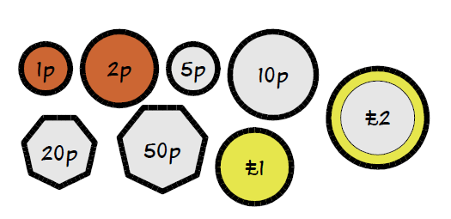
These are the coins commonly used in Britain today.
What is the FEWEST number of coins you need to make
83p (b) £1.34 (c) £5.27

Slide 22
Calculate this
£5.75 + £12.75
£1 ÷ 5
£189.25 – £47.05

Slide 23
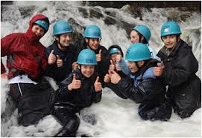
Stream Scrambling
Enjoy a fun filled day climbing waterfalls, wading through streams and navigating fun obstacles.
A picnic lunch will be provided halfway through the day at an extra £7 per person.
Safety equipment included at no extra cost.
Adult tickets - £30 each
Child tickets – half the price of an adult ticket.
How much will tickets cost for 2 adults and 2 children?
What other extra costs need to be considered?

Slide 24

LOB:
To solve larger word problems involving
money.
Remember:
Your budget is £800, don’t go over!!
Work together as a team.
Work out a few options before choosing the best one.
Be ready to tell the class about your holiday at the end of the lesson!

Slide 25
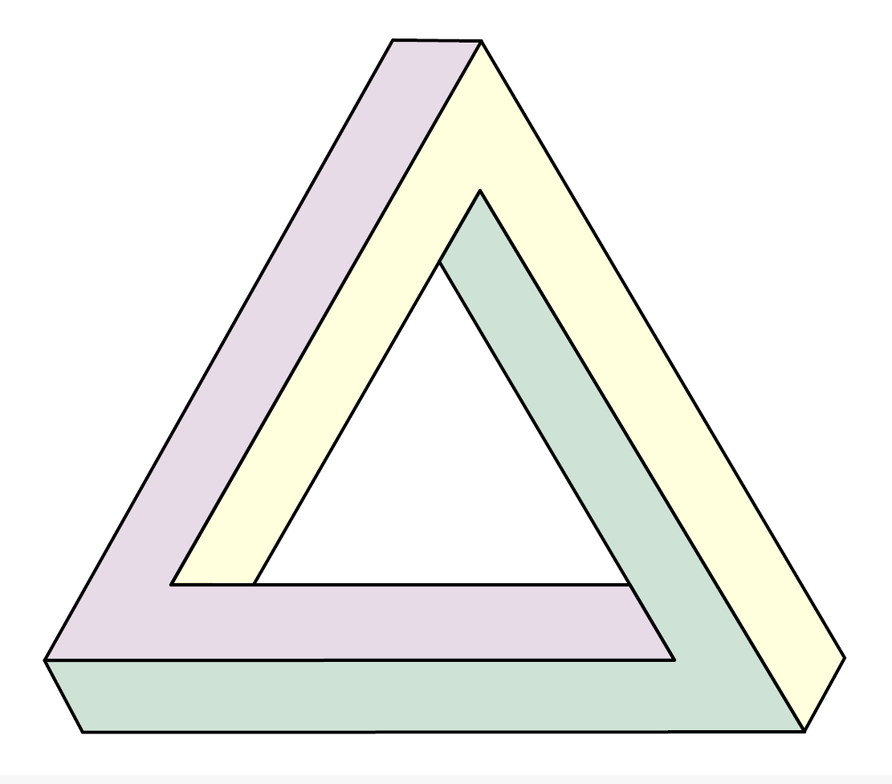
Shape
problems

Slide 26
Guess the shape
Think of a shape.
Your partner can ask you up to 10 questions to help them guess your shape.
You can only answer yes or no.

Slide 27

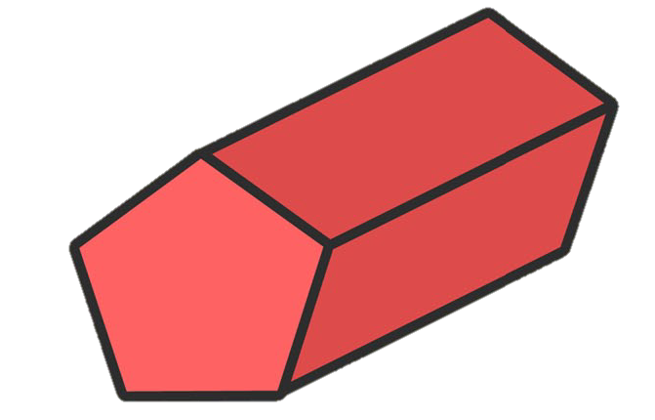
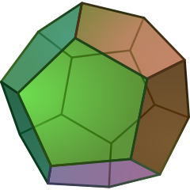
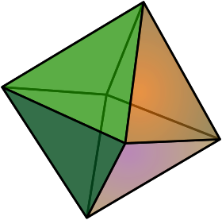





How many of these shapes
can you name?

Slide 28


How many of these shapes
can you name?
Hexagonal prism
pentagonal prism
dodecahedron
octahedron
cylinder
Cuboid
tetrahedron
Cube
square based pyramid

Slide 29

What are the properties of this shape?

Slide 30
Lob: to create a variety of 3d shapes and describe their properties.
What shape can you make using all of your straws? Remember you can’t cut or bend them!
When you work out your shape, write the name of the shape down in your book along with its properties.
What other shapes can you make with your straws?
Extra challenge: can you make a regular decahedron (12 pentagonal faces)?

